Slide 1
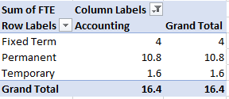
RESULTS
1.TABLE
1

Slide 2
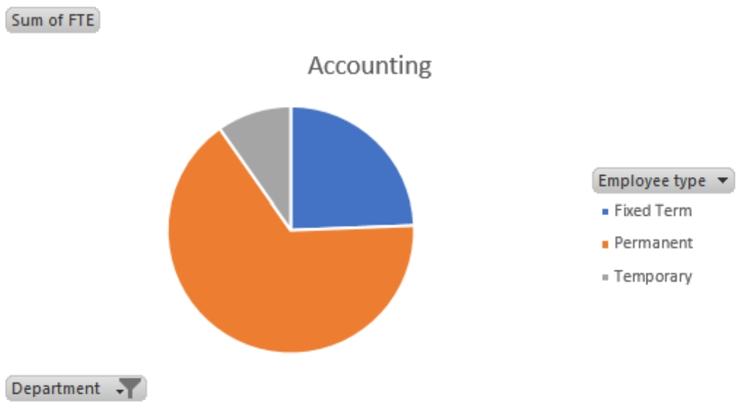
2.PIE CHART

